Slide 1
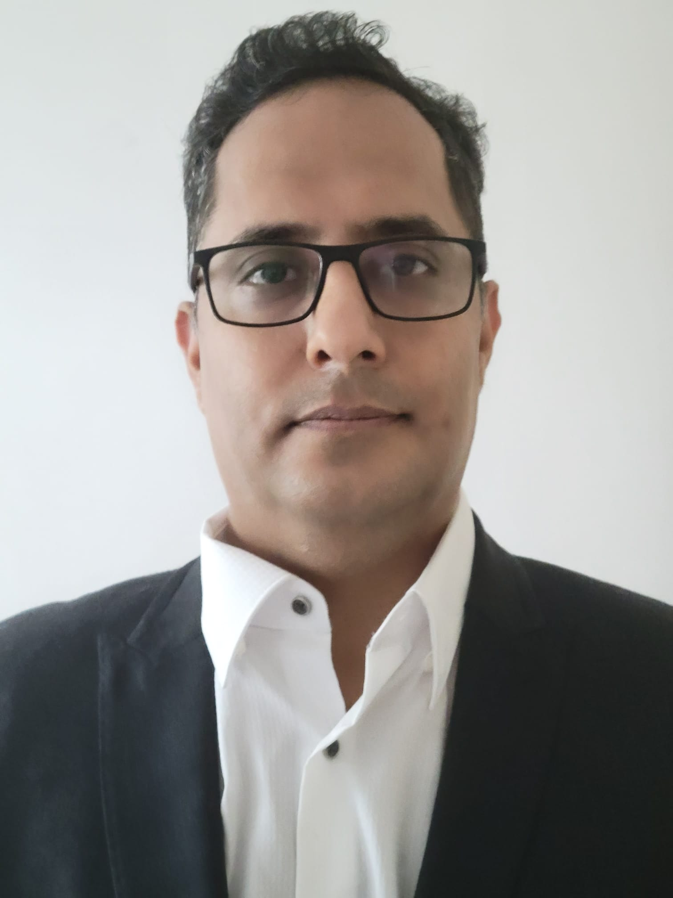
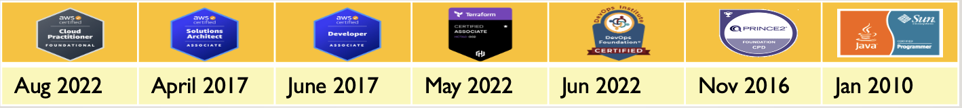
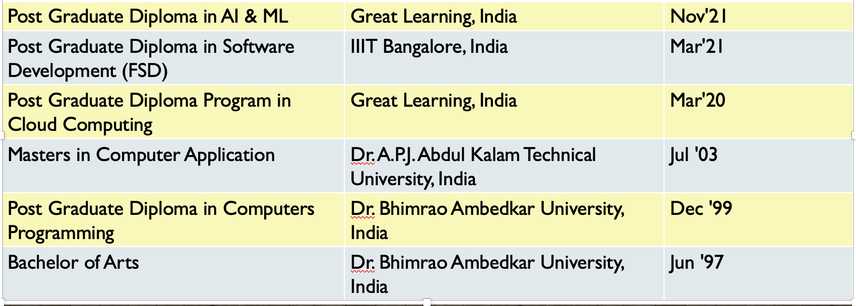
Mayank Chugh
Senior Technical Manager (Cloud + Application)
Email: mayankchugh.jobathk@gmail.com
Mobile: +852 84812040
LinkedIn: www.linkedin.com/in/mchugh44
Git: https://github.com/mayankchugh1977
Summary
Relevant Experience
Hands-on solution-driven IT professional with 18+ years of extensive experience as a consultant, solution architect, Security Designs, project manager, team lead, and senior engineer for multiple software development projects. Focus on pre-sales, product scoping & pricing, solution development, project management, release management, network engineering, and systems administration. Energetic and recognized for having excellent communication and problem-solving skills spanning multiple technical towers and global enterprises.
Client: CHANEL
Participated in Pre-sales activity for providing High availability, Fault tolerant and resilience application to the client.
Contributing as SME for application implementation and Azure cloud for accepted SLA, RPO and RTO.
Working closely with delivery head, fellow Architects and other members for delivering complete IT solutions.
Client: HSBC
Gathered project requirements for setting up application on Cloud through interactions, meetings, and walkthroughs with potential application users functional and non-functional requirements.
Server side API designing, Security Patterns designs decision and Providing AWS architecture for setting up AWS EKS cluster having Jenkins CI/CD pipeline.
Client: Cathay Pacific Cargo Terminal & Asia Airfreight Terminal
Gathered project requirements (150+ of AAT and 35+ of CPSL) through interactions, meetings, and walkthroughs with potential application users and develop business requirements documents (BRD), functional requirements documents (FRD), and user mock-ups. Also, I created 55+ technical responses to Requests for Quotes (RFQs) for customers.
I Provided winning solutions as part of the pre-sales team, which included responding to RFPs and RFIs from existing and prospective clients. Recently, involved in a proposal for the migration of Monolithic to cloud study. Conducted a few POCs for the same Participated in both pre-sales and post-sales activities, including establishing statements of work, responsibility matrixes, and overseeing the technical realization of solutions by delivery teams.
Worked closely with executive sales teams to deliver quotes and full IT solutions in networking, computing, storage, and virtual cloud infrastructure. Also, Designed and developed projects: On-premise Storage move to AWS, OCR using AI Computer vision, AWS IOT using MQTT (pub/sub) for controlling Cold Box for warehouse cargo application.
Monitor SLA and tested application performance to identify potential bottlenecks, develop solutions, and collaborate with developers on solution implementation for 5 Web, 3 Mobile applications. Provided 2nd and 3rd level technical support and troubleshooting to internal and external clients. Team Size - 4 - on-site resources, 4 - offshore resources.
Successfully managed multimillion-dollar revenue accounts including focus on several Completed 15.5K days of works. I have managing releases during all phases of software development life cycle, from requirements analysis through system implementation for more than 2 enterprises projects. Worked closely with customers, internal staff and other stakeholders to determine planning, implementation and integration of system-oriented projects. System development of RESTful API for having interface with HKIA.
Skills
Project lifecycle management; Project manager supervision; Release management; Technical project planning; Project requirements analysis; Build technical teams; Technical documentation understanding; Solution Technical architecture (Application + Cloud); Security Designs/Patterns; Project scheduling and budgeting; Custom software development and database design; System migration/integration; Quality assurance
Cloud Services: AWS EC2, ELB, EBS, S3, VPC, SES, SNS, IAM, RDS, Cloud Watch, Cloud Front, AWS CLI, AWS IOT MQTT (pub/sub);DevOps: GIT, Jenkins pipeline, AWS CI/CD pipeline, dockers, Ansible, AWS ECS, EKS cluster, K8S, Terraform; Languages: Java / J2EE, EJB, Spring Boot, JavaScript, ReactJS, Struts 1.x MVC, PL/SQL, Python; Databases: Oracle, MySql, Postgres; Reporting: iReport, Jasper Report;; Version Control: GIT, SVN, VSS; Web Services: Soap, Rest API Development, Swagger API; Management Tool: JIRA, Maximo, Confluence; Bugzilla, Mantis; Machine Learning: Supervised Learning – Linear/Logistic Regression, Decision Tree, Random Forrest Tree; Operating Systems: Windows (XP, 10), Lunix and Ubuntu; Methodologies: Agile, Iterative, Waterfall Model
Education

Slide 2
Key Result Areas
Solution Architecture
A customer-centric leader with strong analytical, design and problem solving skills
Interacting with clients for business gathering, conducting system analysis to propose/finalise Infrastructure & Application design specifications.
Further conduct mockup interview with teams to discuss functional & Non-Functional requirement and Security aspects; also help in preparing high level design documents for the project;
I contribute teams as SME to the design, development, testing, troubleshooting and debugging during the process phases.
Reviewing design documents, code & approving results during for critical functionalities of the projects; identifying & highlighting risks and issues in project followed by appropriate escalation; providing post-implementation, application maintenance and enhancement support to the client with regard to the product / software application
Production Deployment & Support
Managing product release and working in close coordination with Development, QA, BE (Business Experts) to plan post deployment support
Providing post deployment support till successful release; rendering deployment support statistics for reporting bugs, issues & possible precautions; driving project change orders, rollback and error logs for change analysis
Ensuring continual improvement to ensure excellence in delivery through metrics-based measurement process & define quality management principles, & processes
Holding review meetings to monitor progress of the project as per schedule / budgets and ensuring timely completion and delivery of the project to the client
Nurturing and deepening strong rapport with key stakeholders/partners/vendors for successfully establishing sound business relationships
Developing project baselines; monitoring & controlling projects with respect to cost, resource deployment, time over-runs and quality compliance to ensure satisfactory execution/delivery of the same
Project Execution
Manage projects including planning and execution; implementing project plans within preset budgets and deadlines; performed on-site and offsite tasks within a project scoping document, including the design, specification, and integration of software products within various customer environments.
Monitoring project progress and outstanding issues; ensuring the quality and timeliness of the deliverables; reporting on the project’s progress
Interacting with stakeholders to analyse and evaluate system program needs
Understanding the customer’s needs and expectations and managing resources to achieve customer satisfaction, ensuring zero defect project deliverables
Conducting quality & security audits and preparing various project teams for external audits/certifications; interacted with pre-sales & sales teams in ensuring that new Request for Proposals (RFP) was properly planned for execution
Working closely with third-party vendors & contractors to manage & coordinate projects with the business units and other IT departments, where necessary
Provided overall leadership to the entire project team including managing deliverables of other functional team leaders

Slide 3
Cloud Projects & POCs
Storage S3, CLI - Cloud Computing on AWS
On Premises File Storage to AWS S3
This design document provides the details of file upload Migration from WOS files storage to AWS S3 bucket logic. In-addition, This enhancement provides the capability to upload the image/document/video and store the files in AWS S3 Bucket instead of local drive.
Skills and Tools - S3, AWS SDK (Java), awscli
CloudFormation | AWS CLI - DevOps
Create web server instance in an AZ, Create Target Group, Create Load balancer
Skills and Tools - Cloud Formation Template, AWS CLI
Moving & Deploying a Web App to AWS Fargate -- Containers & Microservices
In the last decades, small and large enterprises have invested heavily in developing bespoke applications. Since these applications have been built and enhanced over a period of time, they are complex and any form of re-engineering to convert it to smaller, modular and independently hosted services is difficult. Managed Container Services from cloud providers allows predictable and reproducible packaging of such apps. This project moved & deployed a classical web app to AWS ECS containers.
Skills and Tools - Docker, ECS, Load Balancer, Apache Tomcat
Building an Automated Business Process using Managed Services on a Public Cloud - Managed Services on AWS
In the connected world, it is imperative that the organizations be interlinked with the customers and vendors. This process has been very sluggish, manual, batch-based and prone to failures. Such Integration design has lead to impaired decision making and delays in the detection of fraudulent actions. This project created an automated, event-based real-time process using managed cloud services that do not have these limitations. Services & Concepts - VPC, IAM, EC2, Athena, SQL, Programming etc.
Skills and Tools - Athena, Dynamo DB, S3, SNS
Cassandra Setup | Master-less arch concepts - Big Data Management & Analytics on Cloud
Install multi-node Cassandra cluster, induce failure, create a key space / table and access from the client.
Skills and Tools - Cassandra, Bigdata
Cloud based file share and sync solution - Cloud Computing on AWS
Implemented a cloud-based scalable and secure file share and sync solution using AWS services. The solution can be easily scaled up to run in your data center or on a public cloud, with its servers, storage etc. completely managed and controlled by your IT team in accordance with a company’s governance and security requirements.
Skills and Tools - EC2, S3, RDS, ELB
Storage | Volumes, S3, CLI - Cloud Computing on AWS
Add volumes to EC2 instance, migrate data from one volume to the other, write a CLI to upload documents to S3 from local machine.
Skills and Tools - EC2, Volumes, S3
EC2 | Multi AZ Deployment | Load Balancing - Cloud Computing on AWS
Deploy multiple EC2 instances in different AZs and experiment with load balancing, target groups and understand the impact of instance failure
Skills and Tools - Amazon EC2, Load Balancer

Slide 4
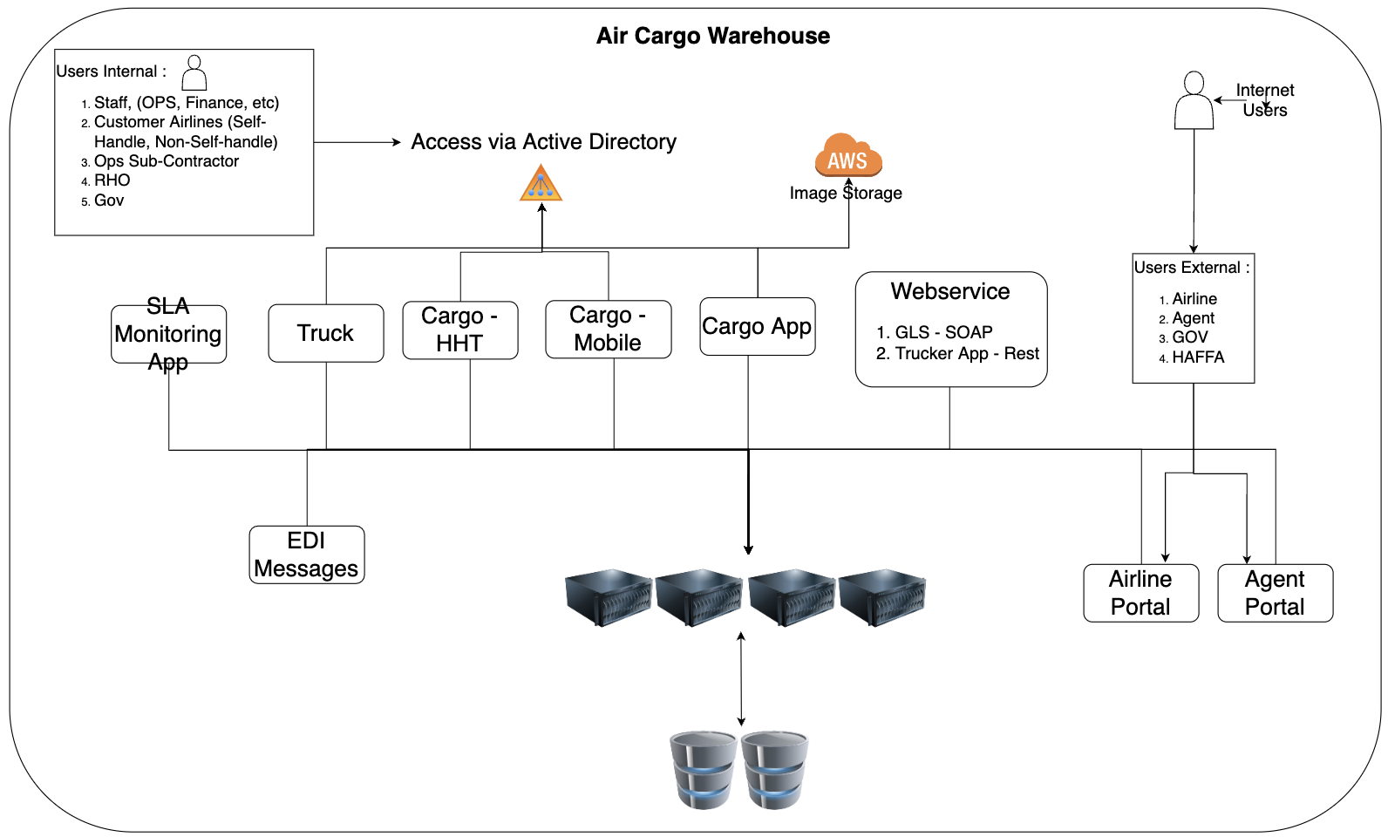
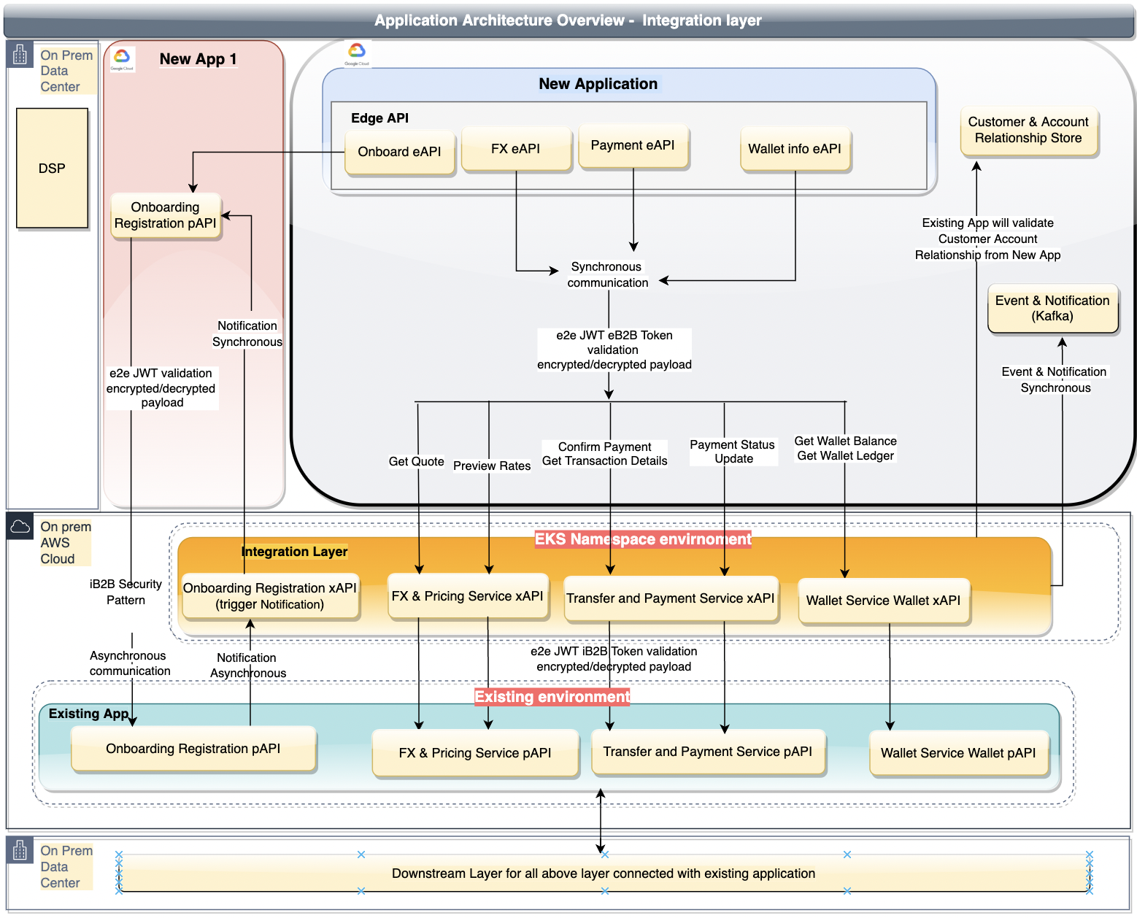
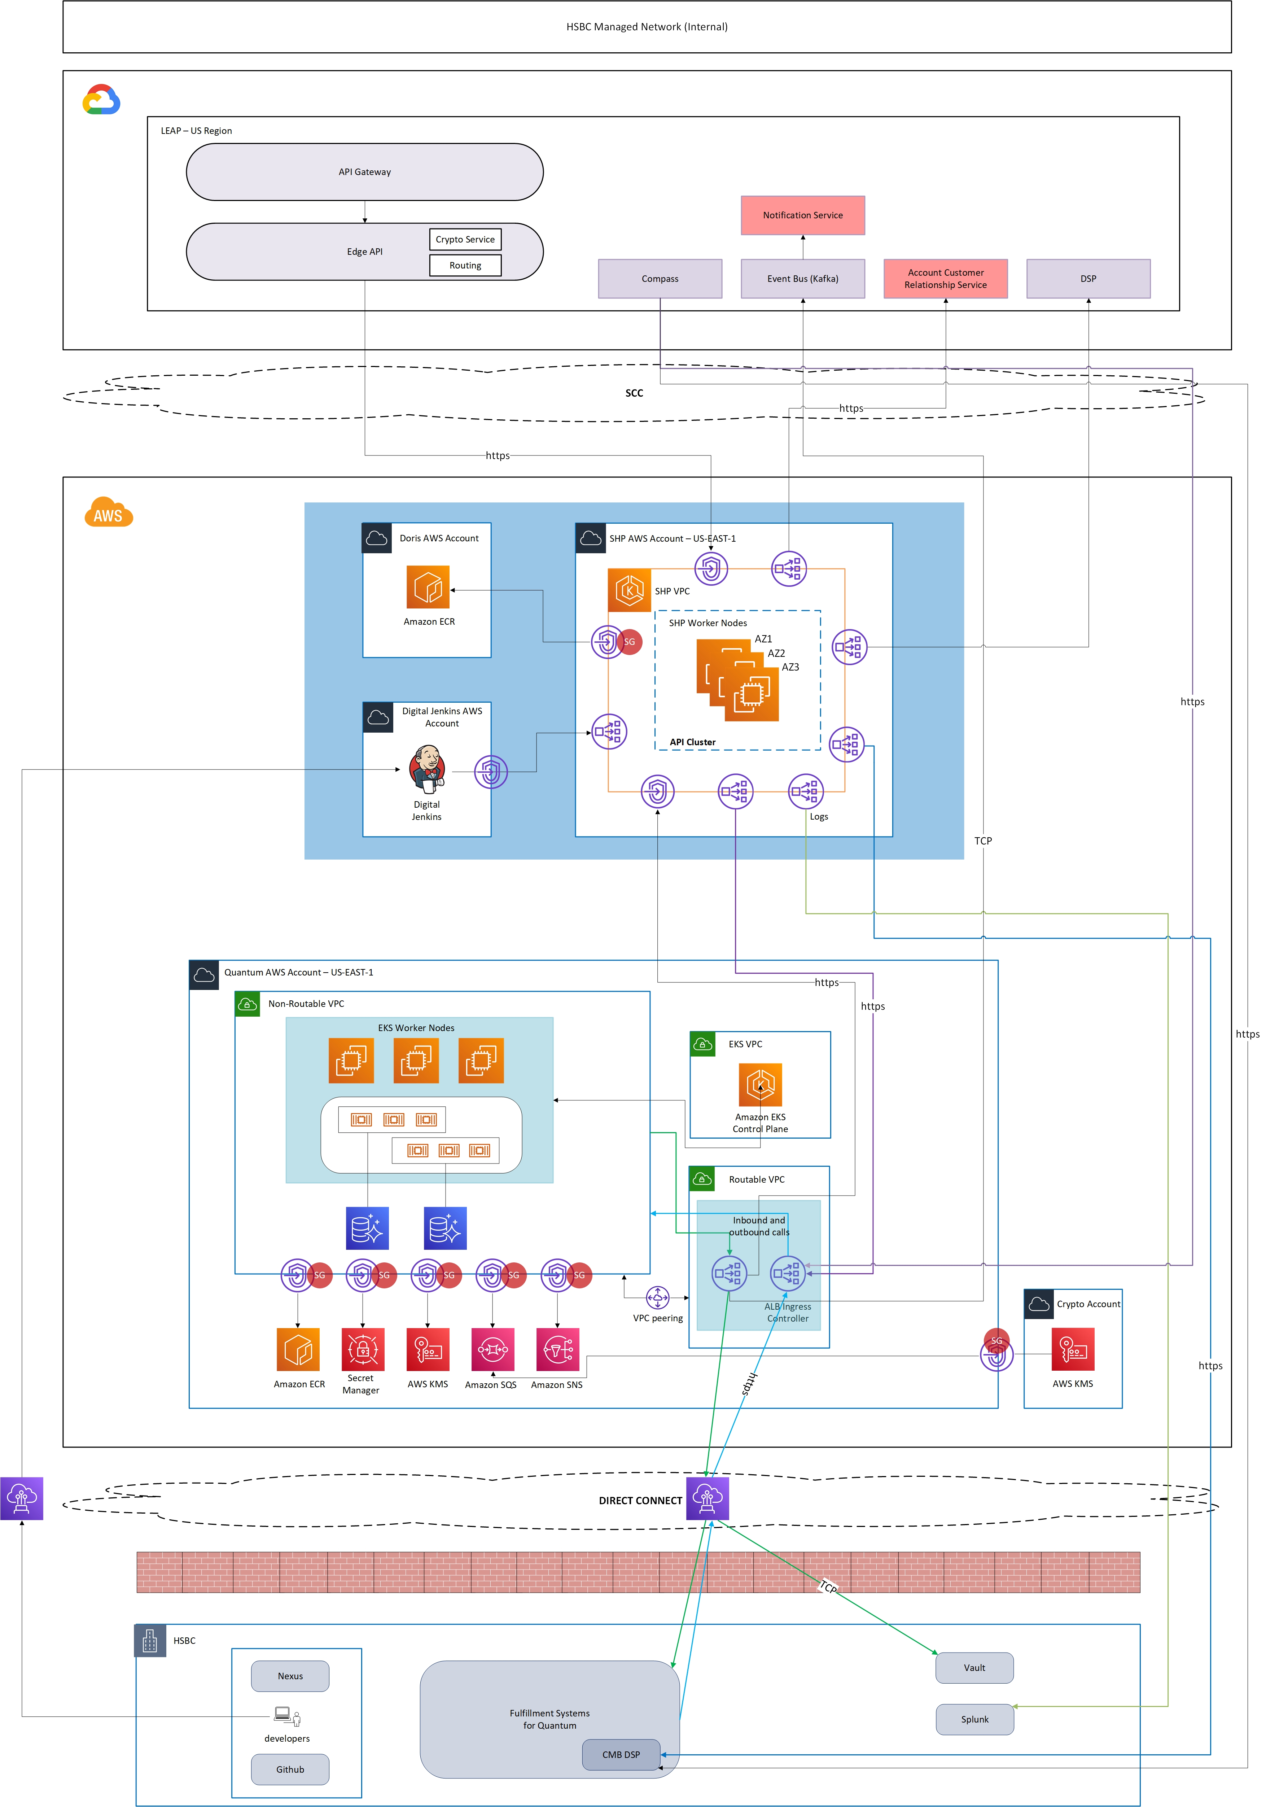
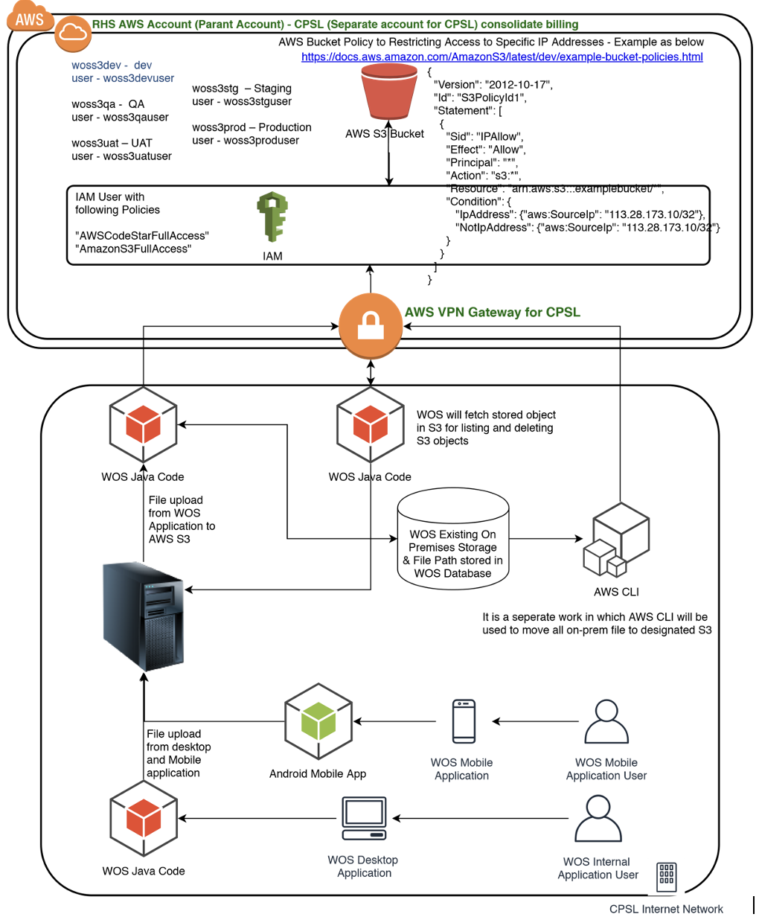
Architecture Designs

Slide 5
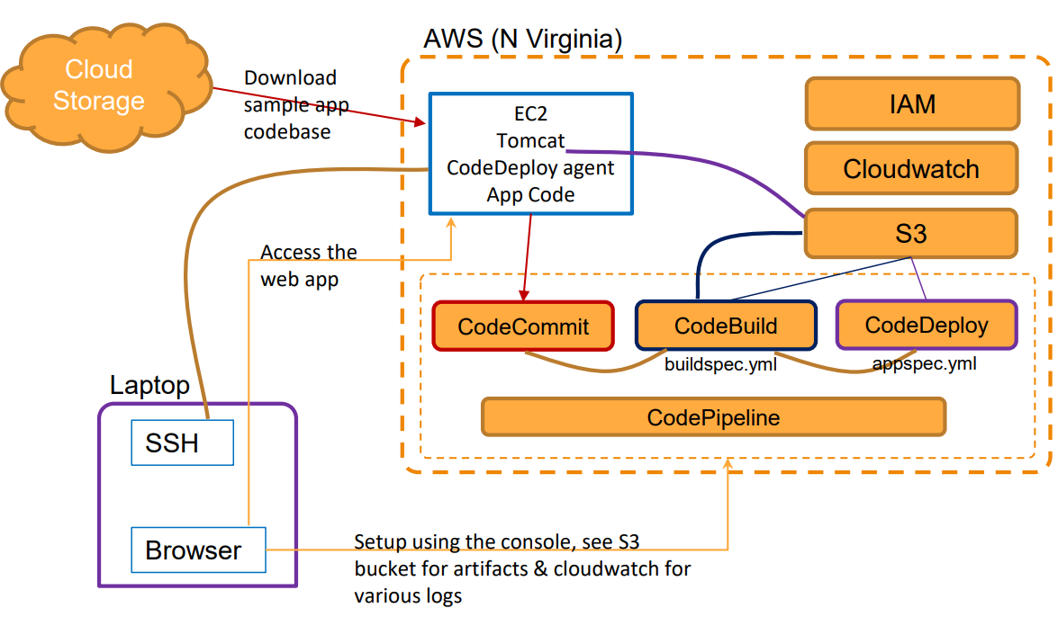
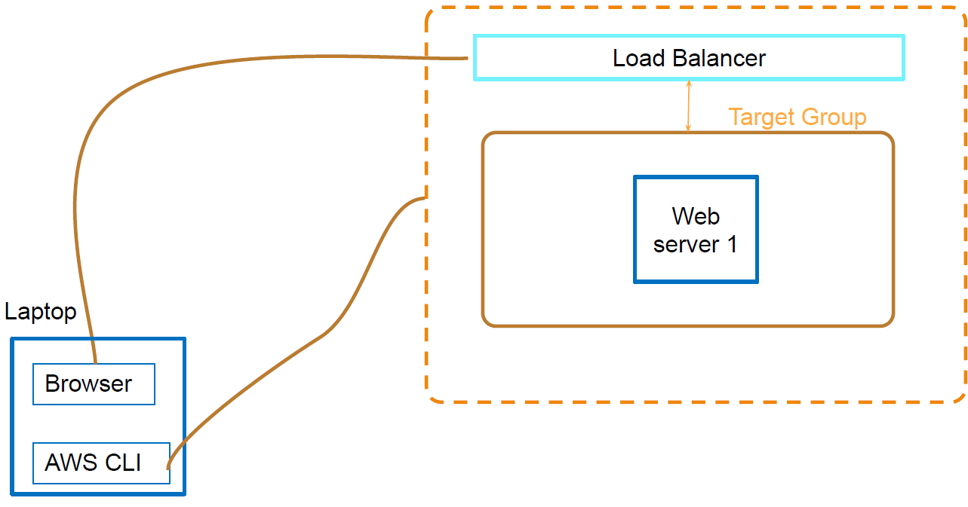
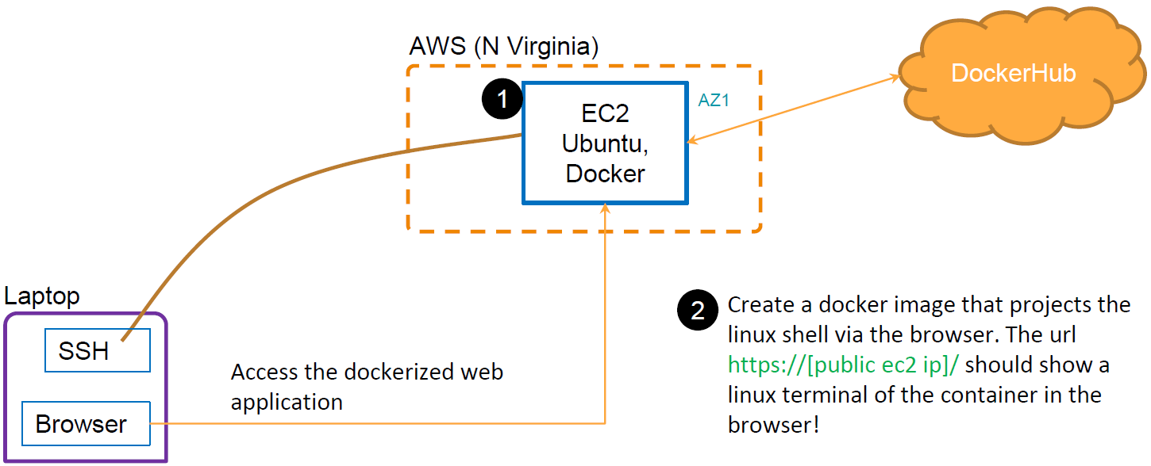
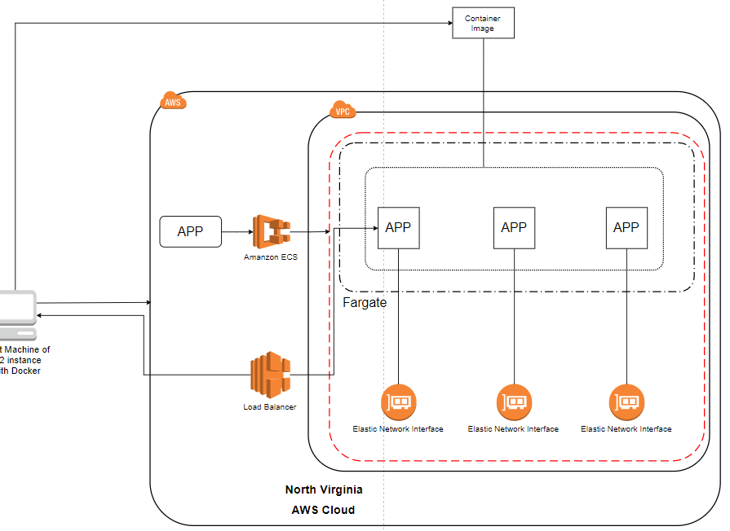
Architecture Designs
DevOps CI/CD | Code Pipeline | Automation - AWS CloudFormation; AWS CLI
Container and Microservices Docker | Images, containers, scripts | Deploying a web application to ECS

Slide 6
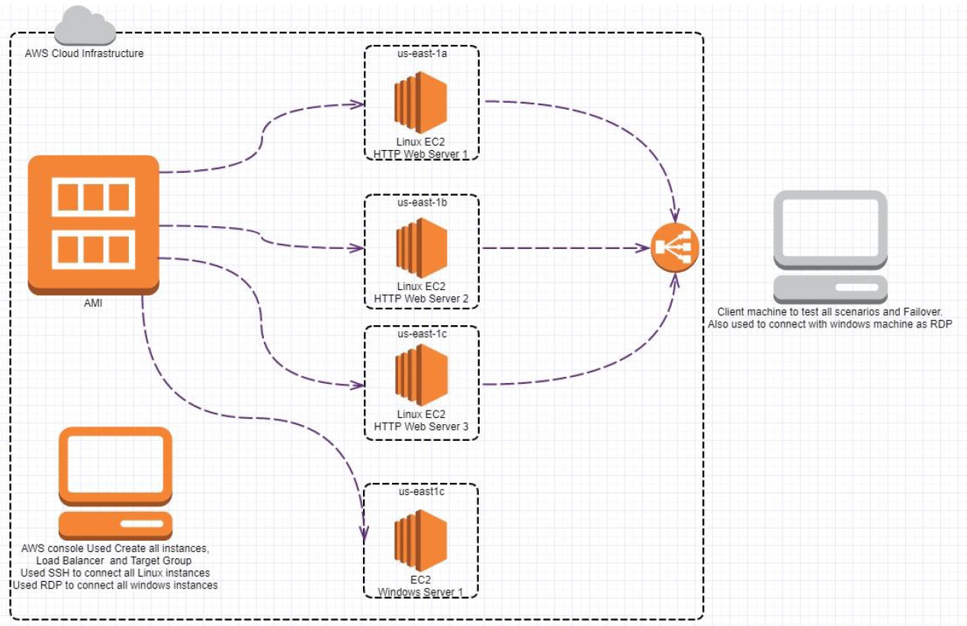
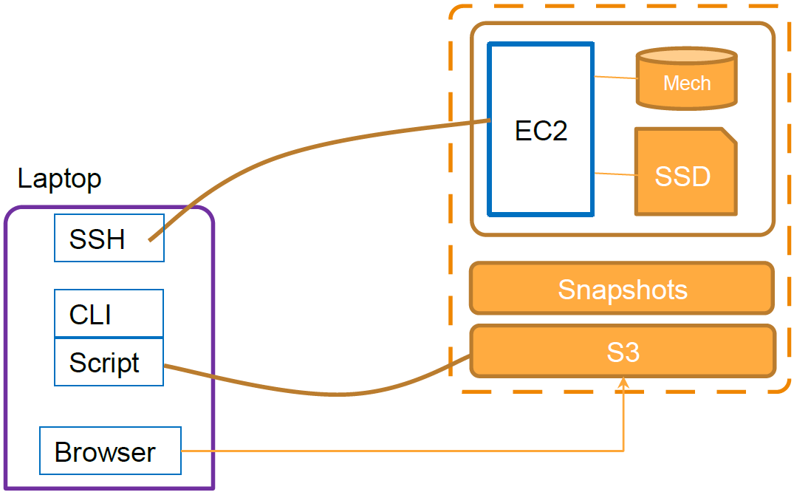
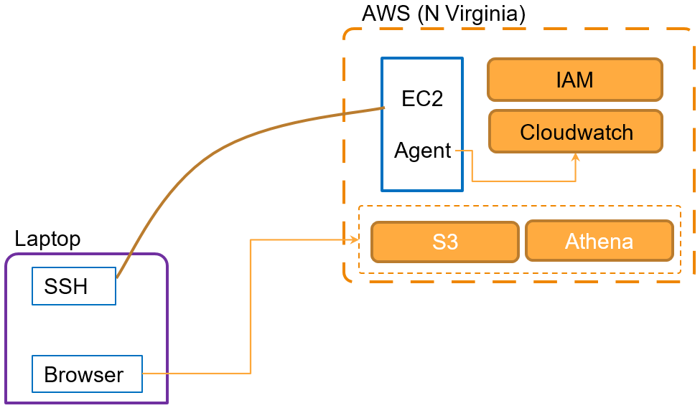
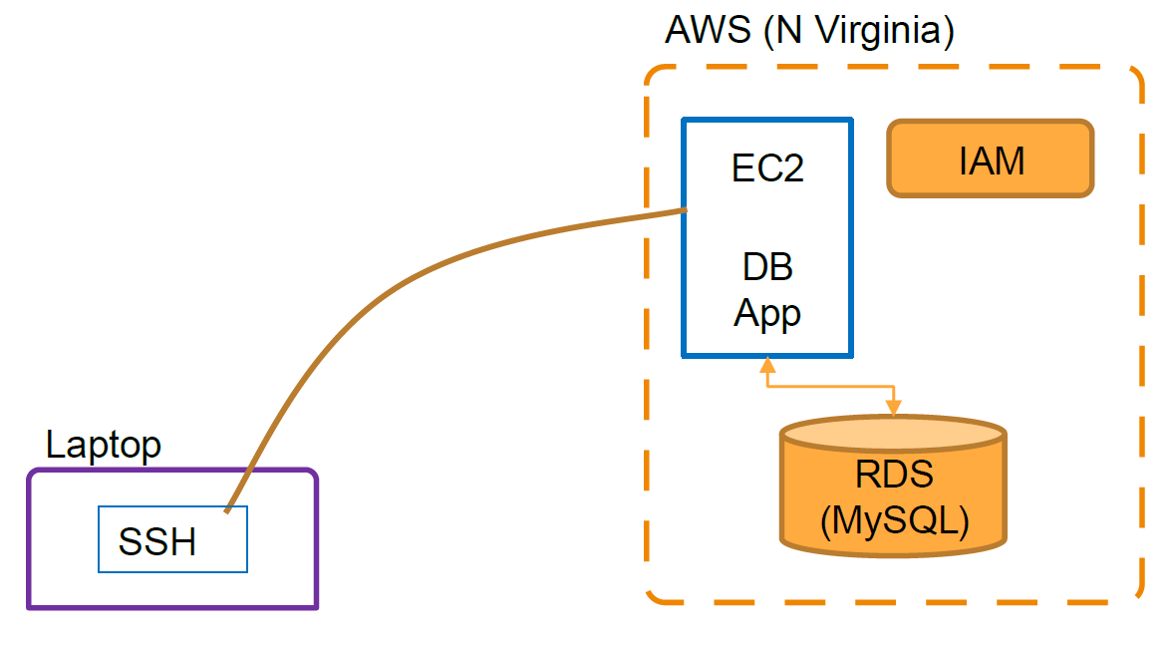
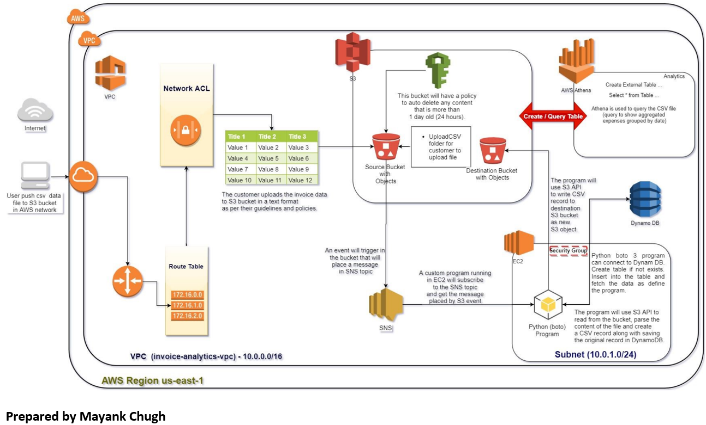
Architecture Designs
EC2 | Multi AZ Deployment | Load Balancing | Storage | Volumes, S3, CLI | Log aggregation| Quick data analysis
Creating a file share & sync solution using ownCloud and AWS | RDS | EC2 database program | Building an Automated Business Process using Managed Services on a Public Cloud

